Slide 1
Private Information Retrieval in Large Scale Public Data Repositories
EPL646: Advanced Topics in Databases
Ishtiyaque Ahmad, Divyakant Agrawal, Amr El Abbadi, and Trinabh Gupta. 2023. Private Information Retrieval in Large Scale Public Data Repositories. Proc. VLDB Endow. 16, 12 (August 2023)
By Stelios Christou: schris10@ucy.ac.cy

Slide 2
What is Private Information Retrieval (PIR)
A protocol that allows clients to privately retrieve data, without anyone knowing the executed query or the data returned
The server, the network and anyone spying on the network should not know or be able to figure out this information
This is very useful as data has now moved to cloud

Slide 3
What is Private Information Retrieval (PIR)
A protocol that allows clients to privately retrieve data, without anyone knowing the executed query or the data returned
The server, the network and anyone spying on the network should not know or be able to figure out this information
This is very useful as data has now moved to cloud

Slide 4
What is Private Information Retrieval (PIR)
A protocol that allows clients to privately retrieve data, without anyone knowing the executed query or the data returned
The server, the network and anyone spying on the network should not know or be able to figure out this information
This is very useful as data has now moved to cloud

Slide 5
Can’t we just encrypt the data on the server?

Slide 6
No… Why?
We don’t own the server
Security concerns

Slide 7
No… Why?
We don’t own the server
Security concerns

Slide 8
Can’t we just save the database locally?

Slide 9
Basic Outline
Server has data stored in array A, size of n
Server returns response r to client
Client wants to retrieve data A[i]
Client sends query q to server
Client receives r

Slide 10
PIR Protocol Outline
Server has data stored in array A, size of n
Server returns encrypted response r to client
Client wants to retrieve data A[i]
Client sends encrypted query q to server
Client receives encrypted r
Client decrypts r

Slide 11
PIR Protocol Must Guarantee
Correctness
Privacy

Slide 12
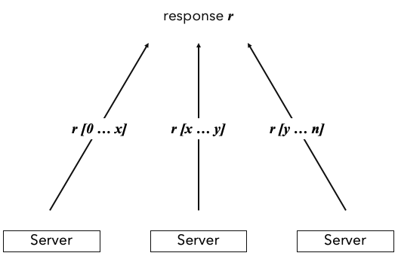
PIR Categories
Information Theoretic PIR (IT-PIR)
Array is replicated in multiple servers
Each server sends differ part of r
Client puts together the parts to get r
Servers must not communicate with each other!
Hard to achieve

Slide 13
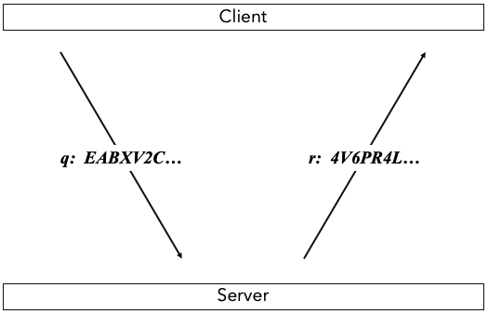
PIR Categories
Computational PIR (CPIR)
Array is stored in a single server
Server computes r
Client receives r
All of this is done with encrypted data!

Slide 14
CPIR - Homomorphic Encryption
Allows for encrypted data computation without the need of decryption
Uses two keys. Secret Key sk, Public Key pk
Encrypt (v, pk): Encrypts message v using pk. Encrypted message is a ciphertext c and its size is bigger than the size of v
Decrypt (c, sk): Decrypts ciphertext c using sk. Decrypted message is the original message v
Add (c1, c2): Adds the two ciphertexts (c1+c2) and gives the encryption of (v1+v2)
Multiply (c1, c2): Multiplies the two ciphertexts (c1*c2) and gives the encryption of (v1*v2)
MultiplyPlain (v1, c2): Same as Multiply but using one cipher and one plain text

Slide 15
CPIR - How Does it Work (Client Query)
Generates sk and pk
Creates query of size n which includes values of 0 and 1
If digit i is 1, it means that the client wants to receive the data positioned at A[i]
If digit i is 0, it means that the client doesn’t care for the data at that index
Encrypts q using Encrypt (q, pk) and sends it to server

Slide 16
CPIR - How Does it Work (Server)
Receives encrypted q
Performs MultiplyPlain between q[i] and A[i]
Performs Add for every multiplication q[i]*A[i] to generate r
Returns r to client

Slide 17
CPIR - How Does it Work (Client Response)
Receives r
Decrypts r using Decrypt (r, sk)

Slide 18
CPIR - Performance
Size of q. Bigger means more execution time
Computation time to generate r. Bigger means more execution time
Size of r. Bigger means more execution time
Each affects the other!
Hard to improve performance

Slide 19
CPIR - Performance
Multi-dimensional arrays
Arrange q and A to
Higher dimensions
Compute response for 2 smaller queries

Slide 20
CPIR - Performance
Multi-dimensional arrays
Smaller queries, bigger response size
r gets bigger with every encryption

Slide 21
Retrieving Multiple Elements
Batch Code (method similar to HashMap)
Database records are split to groups and each group is assigned a code
Codes are distributed in buckets
Queries are encoded to a ser of codes
Server returns corresponding groups based on query codes

Slide 22
How does this work in real life though?

Slide 23
Real Life Application
Clients don’t usually know index i
Multiple element retrieval is applied first
Client picks desired result
Data is retrieved based on client’s choice

Slide 24
What if the server doesn’t save data in an array structure?

Slide 25
Key - Value Retrieval
Data is saved in pairs of <key, value>
Client probably know the key and not the index!

Slide 26
PIR Protocol Extension
Keys are arranged in a binary tree
Phase 1: Search tree to find index based on key using Breadth First Search
Phase 2: Retrieve data based on index

Slide 27
PIR Protocol Extension
Keys are arranged in a binary tree
Phase 1: Search tree to find index based on key using Breadth First Search
Phase 2: Retrieve data based on index
Very time consuming for large amount of data!
What if data changes between the two phases?

Slide 28
Single Round Value Retrieval
Client sends encrypted key
Server performs equality checks to find the key
If equal return encrypted 1
If not equal, return encrypted 0
Builds an encrypted query q, like before

Slide 29
Conclusion
Private Information Retrieval is possible
Research required to improve performance
Research required to apply on SQL queries and other types of queries

Slide 30
References
[Paper] Ishtiyaque Ahmad, Divyakant Agrawal, Amr El Abbadi, and Trinabh Gupta. 2023. Private Information Retrieval in Large Scale Public Data Repositories. Proc. VLDB Endow. 16, 12 (August 2023), 3868–3871.
[Tutorial] https://sites.cs.ucsb.edu/~ishtiyaque/files/VLDB_2023_Tutorial.pdf

Slide 31
Thank you for your time!

